Slide 1
Train the Football Trainers
August 1, 2015

Slide 2
Preview
What your going to hear:
Trainer’s role
Leading a meeting
Emphasizing basics
Game preparation
Managing the game
The “cardinal sins”
Individual position work

Slide 3
Sample Mtg Intro Question
4th & 12 @ A4. A12 retreats into his end zone to pass. Unable to find an open receiver, A12 attempts to throw the ball away. The forward pass goes toward A66 who is two yards deep in the end zone. To prevent an interception, A66 deliberately muffs the ball which falls to the ground. A88 is standing next to A66 and also attempts to catch the pass. Ruling:

Slide 4
Constructing an Association Meeting
I. Gathering, Settling & Organizing
a. Play situation on board or video clip running
II. Call Meeting to Order (5 minutes)
a. Sign-In
b. Recognition of guest
c. Reports & Announcements
d. Agenda Review
III. Quick Quiz – 2-5 questions (5 minutes)
a. Individuals
b. Crews
c. Position Groups
IV. Quiz Answers & Brief Discussion (5 minutes)

Slide 5
V. Play Situations from the Floor (5 minutes)
a. Ground rules
VI. Split into Individual or Combined Groups-with leaders (20 minutes)
a. Referees
b. Umpires
c. Line Judges & Linesmen
d. Back Judges
VII. Leaders Report to Group (10 minutes)
VIII. Topic Presentation (15-20 minutes)
a. Video preferred
IX. Closing & Next Meeting Reminder

Slide 6
Stress Continuous Improvement
Conduit between MHSAA & local
Path to play-offs
Selection criteria
What represents a
“well worked game”
Defining moments

Slide 7
Leadership
Stress Accountability
On the field
Players, coach, fans, media
Judgment accuracy
Off the field
Citizenship
Social media
Leadership thru example
Believe in what you’re preaching
Don’t have to know everything-know how to access
Mentor, Advice, Reassurance & Consolation

Slide 8
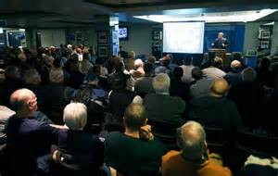
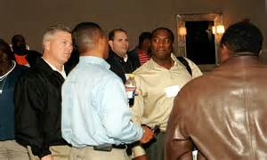
Facilitator
Empower others to assist & present-can’t do in all by yourself
Present 1st program to model
Delegate for leadership & ownership
Select others with intent & purpose
Monitor & assist
Some will embrace others won’t
Offer to share a presentation
Continuous improvement
Concentrated study
Referee Magazine
USA Football
Rom Gilbert
Video & personal observation
Constructive criticism from others
On field work-focus on basics
Practices, scrimmages & games

Slide 9
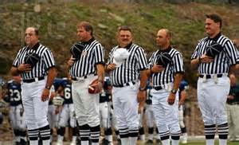
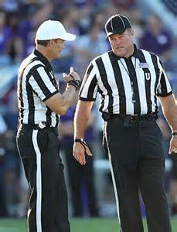
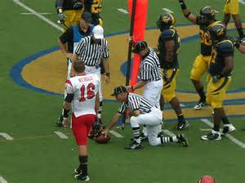
Fundamentals
Understanding positions & relationship to others
Example: U’s A players confirmation for LOS
Rules knowledge & practical application
Primary roles
Players safety
Game management
Mechanics – improves accuracy
Pre-snap routine
Field position
Measurements
Dead ball supervision
Slow down-negative hustle
No ball watching
Look back into field
Head/eyes up
Keep vision wide

Slide 10
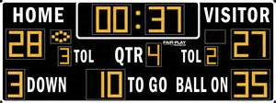
Fundamentals
Signals
Federation approved
Clear, sharp & without emotion
Game clock management
CREW responsibility
Awareness throughout game
Pre-game with clock operator
Correct sloppy timing early
Concentration
Anticipate situation, not call
Football IQ: Time, score & situation
Try not to be surprised by what happens

Slide 11
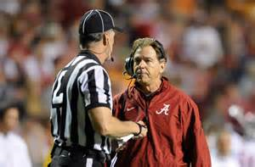
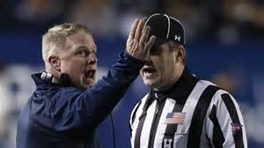
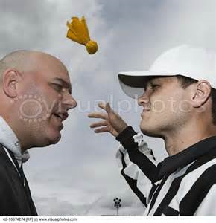
Fundamentals
Communication
Before game
Confirming with crew
travel, arrival, etc.
With school
During game
Verbal & non verbal
With coaches
“Don’t go often, don’t stay long.”
Coach initiated
Off field, in box
Brief & concise
Official initiated-preventative only
Warning for ILS & SLI
Body language

Slide 12
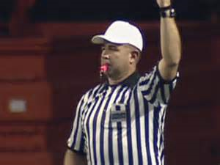
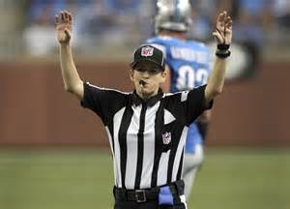
Whistle Mechanics
Cardinal Sin #1
Pulling pin on grenade
Don’t fear, respect it
Process to declare play dead
Normally 1 maybe 2 whistles
See leather
Criteria to blow play dead
Assistance from others

Slide 13
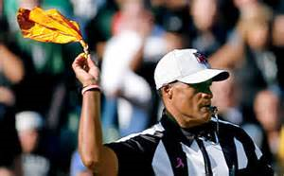
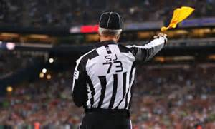
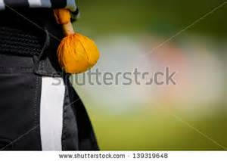
Calling Fouls
Cardinal Sin #2
Call only obvious fouls
Make ‘em be HUGE
Not fishing for minnows
Required criteria
Must see entire action
Visible
Material
Take something away
Place in category
OH – grab & restrict
DPI – early contact
UNS – taunting an opponent

Slide 14
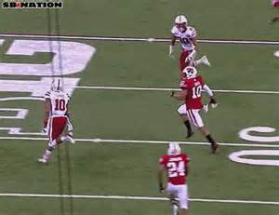
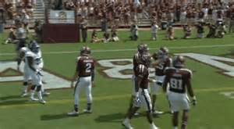
Consistency & Stepping Up
Must be consistent throughout game
Fouls qualifying early v late or vice versa-
should not be any difference
Same philosophies on “both sides of field”
Safety & unsporting behavior
No tolerance for safety or conduct fouls
Setting the crew standard
Stay off marginal stuff-make ‘em “BIG!
Apply all aspects of criteria
Must be able to put in category
Stepping up
Making the big call or not making one
Assistance to crew when needed

Slide 15
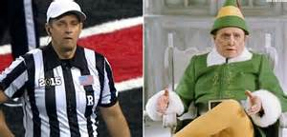
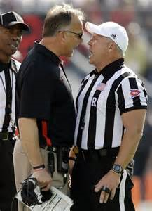
Referee
Leading & preparing crew-standards & expectations
Pre-season & during season
During the game & post game
Microphone use
Key resource-use it
Know what you’re going to say
Fouls-accepted & declined
Signals
Initial starting position & movement
Stay with QB
Keep depth & width
Line play coordination with U & LOS
Clean up behind play
Short punts OB

Slide 16
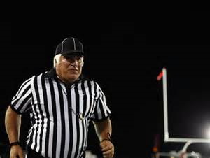
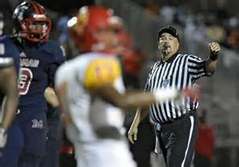
Umpire
Initial starting position & movement
Everything with purpose
Spin on passes below head level
Slow down on dead ball action
Line play coordination
Front side
Back side
Penalty enforcement & coordination
Communication
With crew
With players

Slide 17
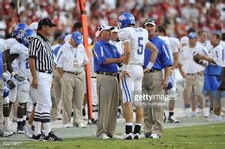
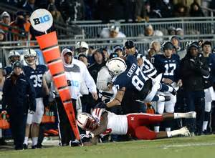
Line Judge & Linesman
Initial starting position & keys
Work wide
Assist WR’s to get on LOS
Eligible receiver responsibility
LOS infractions – must be solid
FST, DOF & ILF
Warning process to get & keep
formations legal
Passes near LOS-know ahead/behind
OPI & IDF
Forward progress & LTG
Whistle control
Cross field mechanics
GL mechanics
Inside 5-go immediately to GL

Slide 18
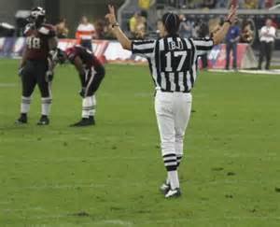
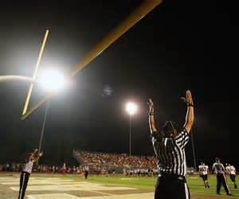
Back Judge
Dead ball mechanics
Maintain depth
Head/eyes up
Look for players chasing
Counting B players
Punt mechanics
Must maintain depth & width
Scrimmage Plays-maintain depth
Goal line & end line
OPI awareness
Formation recognition
Time, score & situation

Slide 19
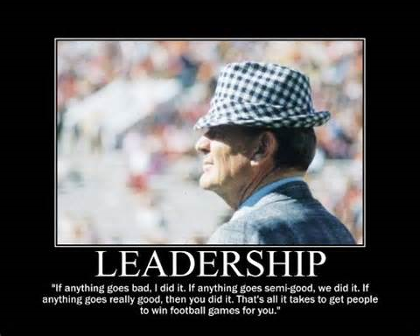
Summary
Understand your role
“Continuous improvement” facilitator
Keep meetings moving
Limit to 90 minutes
Plan & organize transitions
Use video to illustrate
Utilize multiple resources
Federation
USA Football
Rom Gilbert
Focus on the basics
Reinforce mechanics

