Slide 1
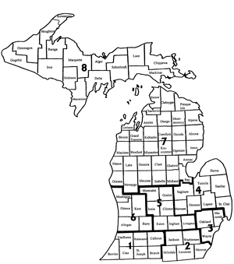
Making
Good
Associations
Great
July, 2015
Freddy Krieger
Secretary, Basketball Trainer
Fruit Belt Officials Association
Berrien County, Michigan
www.fruitbeltofficials.org
Notes:
First “MGAG” took place at one of the breakout sessions at Officiate Michigan Day in July, 2015.

Slide 2
One or Two Word Response
Written on Card
33 Seconds
Hand In When Done
SURVEY QUESTION

Slide 3
What is the one thing that your association is really good at, the one thing your do best, the single thing you’d best be known for?
SURVEY QUESTION
Notes:
QUESTION: If an interested observer were to “follow our association around” for a month or two, what one word would that person give for the above question? (One answer only)

Slide 4
Notes:
A great book for any leader . . . we’re not going to settle on “7 habits of a highly effective association” today (we did that at the 2013 MGAG, where association leaders went home with a great variety of things to work on implementing.

Slide 5
THE ONE KEY HABIT
OF A
HIGHLY
SUCCESSFUL
LOCAL OFFICIALS ASSOCATION

Slide 6
The MAIN THING
is that
the MAIN THING
is
the MAIN THING
THE ONE KEY HABIT OF A HIGHLY
SUCCESSFUL ASSOCATION

Slide 7
There are a Multitude of Things a
Local Approved Association
COULD be doing and perhaps
SHOULD be doing:
Recruitment
Charity
Public Relations
Social Events
Giving Scholarships
Assigning Games
Discipline
Meetings
Elections
Video
Guest Speakers
Observation
Ethics
Communication
MHSAA Assignments
Retention
Finances
Mentoring
LOTS OF “THINGS”

Slide 8
The MAIN THING
is that
the MAIN THING
is
the MAIN THING
What is that “MAIN THING”???
Notes:
Today, however, we’re aiming to discern just ONE THING, not many. THE MAIN THING . . .

Slide 9
Notes:
The MHSAA Officials’ Guidebook is the document that gives a local approved association its “charter.” And with it, it’s mandated key responsibility.

Slide 10
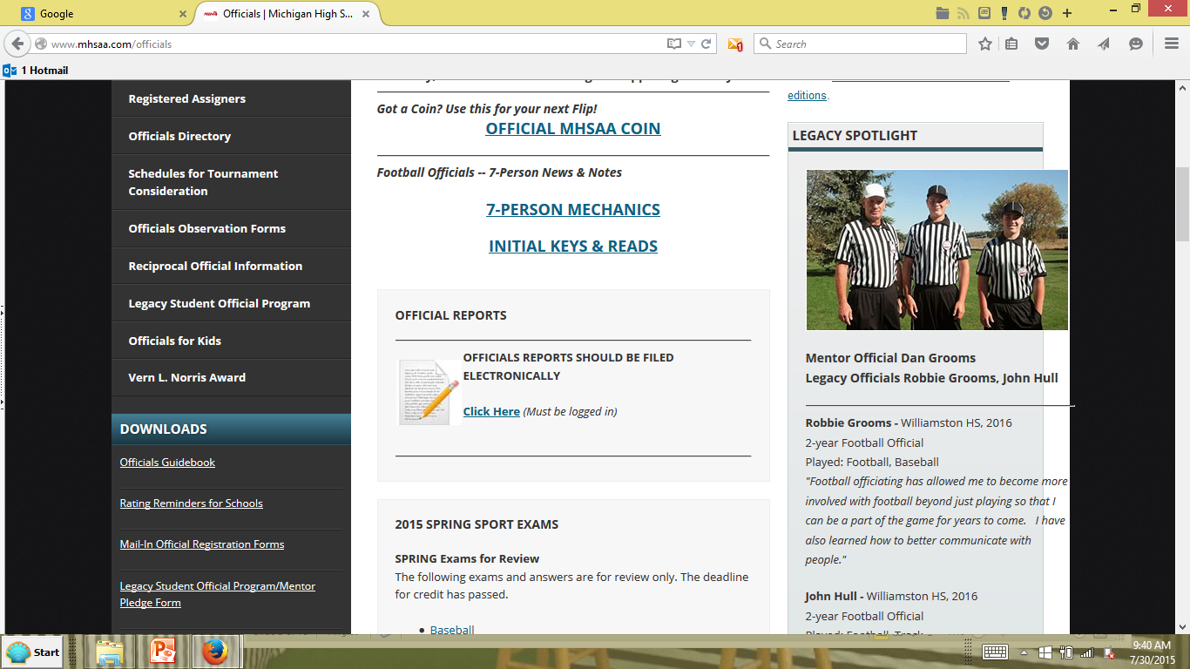
OFFICIALS GUIDEBOOK

Slide 11
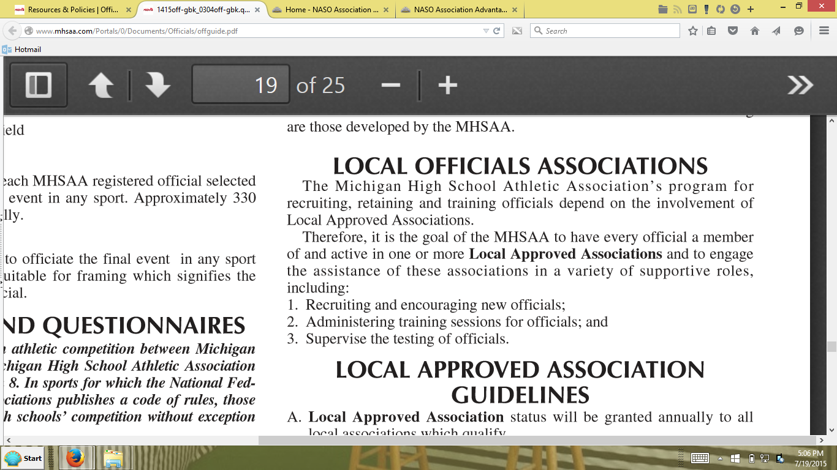
Notes:
Note what the goal of the MHSAA is for all officials . . .

Slide 12
Why?
Notes:
Why is that a goal?

Slide 13
OFFICIALS GUIDEBOOK
Notes:
Because . .

Slide 14
“New officials will go where they are invited
And stay where they are welcomed and ___________.”
-- Jack Roberts, OMD, July 2013
THE MAIN THING
Notes:
THE MAIN THING? Training!

Slide 15
T R A I N I N G
MHSAA MANDATE

Slide 16
3. At least one experienced official in each sport will be nominated by the
Local Approved Association to the MHSAA to become educated as
the TRAINER of officials in a specific sport.
4. The MHSAA will finance the in-service for TRAINERS for the biannual
preseason in-service required for a TRAINER to maintain
certification as a TRAINER.
5. Bi-annual training opportunities, conducted by an MHSAA Certified
TRAINER, must be offered to each member official by an MHSAA
Local Approved Association.
6. TRAINERS are required to conduct six hours of “rookie” training
annually to prepare novice officials for lower level regular season
officiating opportunities.
7. TRAINERS are required to annually conduct a mechanics clinic of at
least three hours for all association members, in each sport for which
the association provides officials.
MHSAA MANDATE
Notes:
From the MHSAA Officials’ Guidebook . . .

Slide 17
B. Trainer Program: Trainers are required for Approved Associations
which sponsor baseball, basketball, competitive cheer, football, ice
hockey, boys lacrosse, girls lacrosse, soccer, softball, swimming &
diving, volleyball and wrestling.
1. Individuals selected to earn the title TRAINER must bi-annually
qualify by meeting specific minimum standards.
2. A TRAINER should have seven years varsity experience in the sport
for which he/she is endorsed by the Local Approved Association.
3. A TRAINER shall have demonstrated communication skills which
identifies him/her as an empathetic teacher and sensitive mentor.
4. A TRAINER must be endorsed and appointed by the Local Approved
Association of which the official is a member. A league or conference
may request appointment of TRAINERS through a Local Approved
Association.
MHSAA MANDATE
Notes:
From the MHSAA Officials’ Guidebook . . . (cont.)

Slide 18
5. A TRAINER must be committed to the sport. Working with other
TRAINERS, supporting the MHSAA training philosophy and
dedication to study and teaching development are indications of
commitment.
6. A TRAINER shall be an active member, in good standing, of a Local
Approved Association.
7. A TRAINER shall be currently registered and attend a current
MHSAA rules meeting in the sport for which he/she is a trainer.
8. A TRAINER will undergo training in the initial year, prior to
conducting training classes and prior to the sport season beginning.
9. A TRAINER will participate in continuing in-service training provided
by the MHSAA every other year to maintain training certification.
10. TRAINERS will accept that their TRAINER candidacy status is
subject to review by the MHSAA and may be denied or revoked if it is
determined to be in the best interest of the MHSAA.
MHSAA MANDATE
Notes:
From the MHSAA Officials’ Guidebook . . . (cont.)

Slide 19
No training
Little training
Trainer only a figurehead
Association can’t say no to a volunteer, so . . .
Trainer riddled with unapproved and bad habits
Training: rule sermons;; no interactivity or on-court elements
Training scrimmages offer no without feedback (cover games)
Trainers interested only in their own schedules
Rules meetings too far to attend
Trainer knowledgeable and passionate but not an effective teacher
Symptoms of a Problem
Notes:
At camps and clinics – wherever and whenever I meet officials – I try always to ask one question: “How’s the training in your local association?” Sadly, here’s the negative answers I have too frequently gotten . . .

Slide 20
“Why raise the bar? We’re just right the way it is now.”
Assigners assigning officials not members of a LAA
LAA leaders in it for their own power or benefit
Trainer anointed only because s/he does college
Perceived illegitimate post-season assignments
General meeting agenda -never a report from the trainer
Trainer is an honorary office given for years of service
Training meetings are all war stories; new officials made fun of
Trainer: “Who cares? I’ve already got the games I want anyway.”
Nobody’s going to benefit from it anyway, so why offer training?
Symptoms of a Problem
Notes:
These responses reveal that, in many areas of our state, there is a problem . . .

Slide 21
Culture and Attitude
Personal Agendas
History
“Politics”
Laziness
>
>
>
>
>
>
>
BARRIERS and HINDRANCES
to “THE MAIN THING”

Slide 22
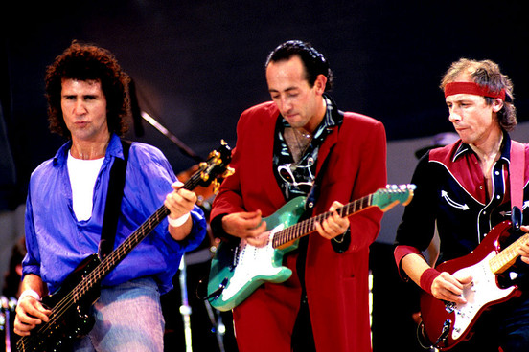
A CONDITION IN OUR STATE
Notes:
In many areas and in many associations, the situation can best be described as “Dire Straits.”

Slide 23
What’s the MAIN THING
in your Local Officials’ Association?
What’s the STATE OF TRAINING
where you’re a leader at?
SELF-ASSESSMENT
Notes:
But let’s not talk about “them”. Let’s look at ourselves in the mirror and do a little self-assessment . . .

Slide 24
“The main thing
is to KEEP . . .
“The main thing
is to MAKE . . .
We Need a Revival, a Reawakening
Notes:
Based on your honest reflection, some of you may need to return to your home area and KEEP the main thing the main thing. You’re doing training now – and it’s the prime reason for your existence - - and what you need now to do is return home and KEEP it that way and improve what you’re doing now. Others of you, however, are busy with MANY THINGS, but THE MAIN THING – training – isnt one of them. On the average, statewide, we could use a revival, a reawakening to the prime purpose for our associations – training!

Slide 25
Clarify and Codify
Stipulate when you Nominate
Do an Archaeological Dig . . . into Your Bylaws
Liturgize and Maximize Your Statement of Purpose
Appointed, not Volunteered
Reviewed for Reappointment, not Recycled or Regurgitated
IDEAS
Notes:
Here are some ideas to try . . .

Slide 26
Disassociate Your Association from any Assigning Function
Not for Power and Prestige, but Selfless Service for Sake of Others
Train the Trainer, if/when Necessary
Trainer: Decide if it’s a Doer or Delegator Position
Anything on the horizon from the MHSAA?
O.D.O. ?
IDEAS
Notes:
More ideas

Slide 27
Clarify the trainer’s MHSAA mandated responsibilities:
…bi-annual training opportunities for each member official of the Local Approved Association
…six hours of “rookie” training annually to prepare novice officials for lower level regular season officiating opportunities
…annual mechanics clinic of at least three hours for all association members
… three educational meetings per year, per sport in which they are registered or one meeting per month during the specific sport season.
Institute these as expectations upon both trainer and member.
CLARIFY

Slide 28
Codify trainer’s responsibilities in your bylaws:
The Sports Trainers shall:
1. Serve for a term of one year and are eligible for reappointment with no term limits.
2. Be appointed or reappointed annually by the board upon an annual review which shall be conducted by the board following the spring general meeting.
3. Be accountable to the board to maintain a training program in accord with the responsibilities expressed in the most current MHSAA “Officials’ Guidebook”.
4. Give an account at each general meeting of previous training held and upcoming training planned. In the case that attendance is not possible due to schedule, valid excuse shall be communicated to the president prior and another representative of that sport appointed by the trainer to issue the report.
5. Organize and schedule at least three rules meetings for baseball, basketball, football, softball, volleyball and wrestling member officials each year.
6. Prepare and distribute educational, training aids, and recommended officiating procedures to members.
7. Record unusual game situations encountered by members and ascertain correct rulings, utilizing the state association as a resource if necessary
CODIFY
Notes:
One association which details this in it’s bylaws – a job description.

Slide 29
EXAMPLE EXPRESSION OF PURPOSE IN BYLAWS:
The mission of the association is:
1. To provide training.
2. To provide a forum for regular rules and mechanics study.
3. To promote the positive image of officials in our community.
4. To promote members’ growth by engaging speakers of interest.
5. To further our avocation by recruiting, training, and integrating new officials.
HOW THAT SHOWS UP AS LITURGIZED:
MINUTES
Spring General Meeting - March 23, 2015
Opening was at 6:33p and greeting was given by President ___________. The association statement of purpose was read by _______________.
Secretary’s report by . . . . . .
LITURGIZE
Notes:
To “liturgize” is to repeat something significant so that those who say it and hear it believe it. Here’s how one association has done this with its expression of purpose, which testifies to the fact that training is number one.

Slide 30
For Leaders
(to make…to keep…)
For Trainers
(to maximize effectiveness in training)
For Officials
(without a Trainer)
RESOURCES

Slide 31
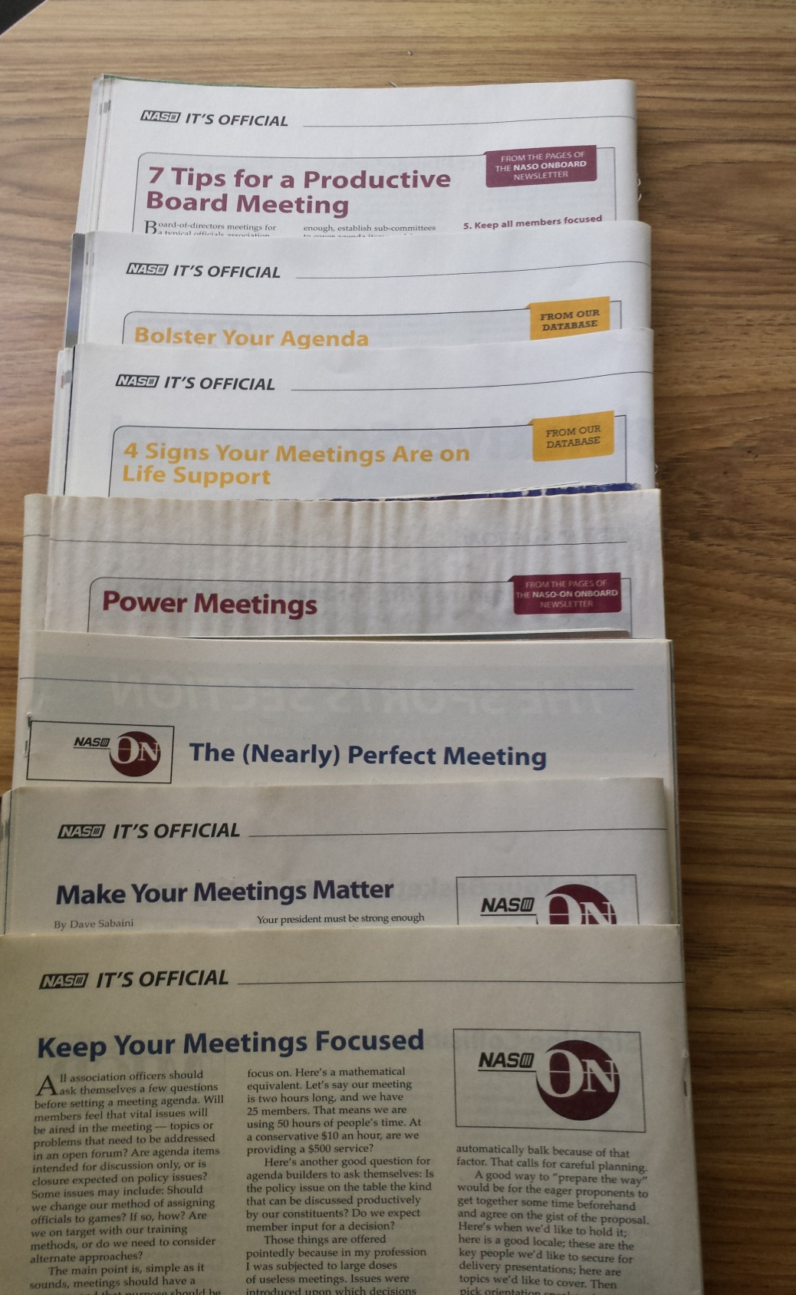
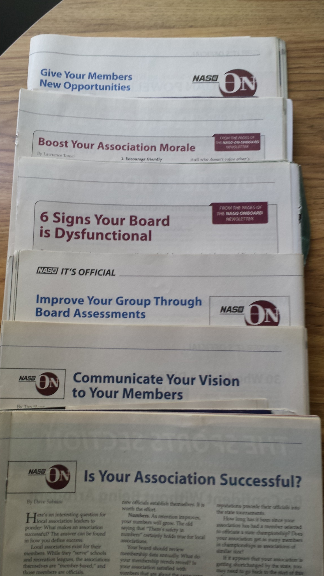
Notes:
Association resources in the middle section of Referee magazine, NASO edition . . .

Slide 32
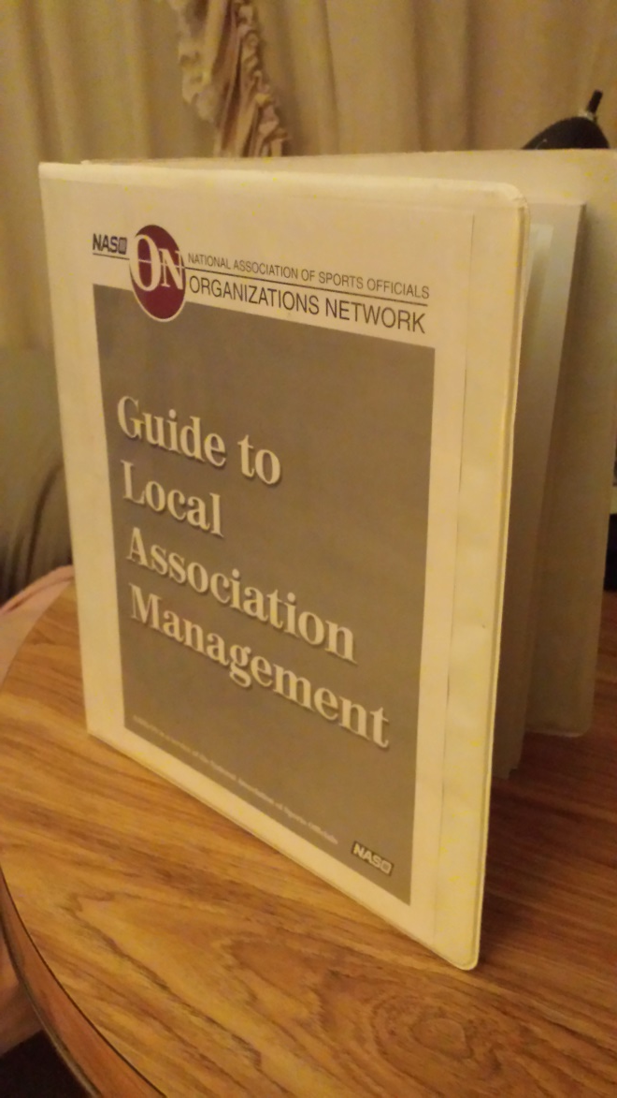
NASO - ON
Notes:
This each association should have received if they had a representative at Officiate Michigan Day back in 2013. A manual of “best practices for any local association, including training. This NASO-ON has been replaced by . . . (see next…):

Slide 33
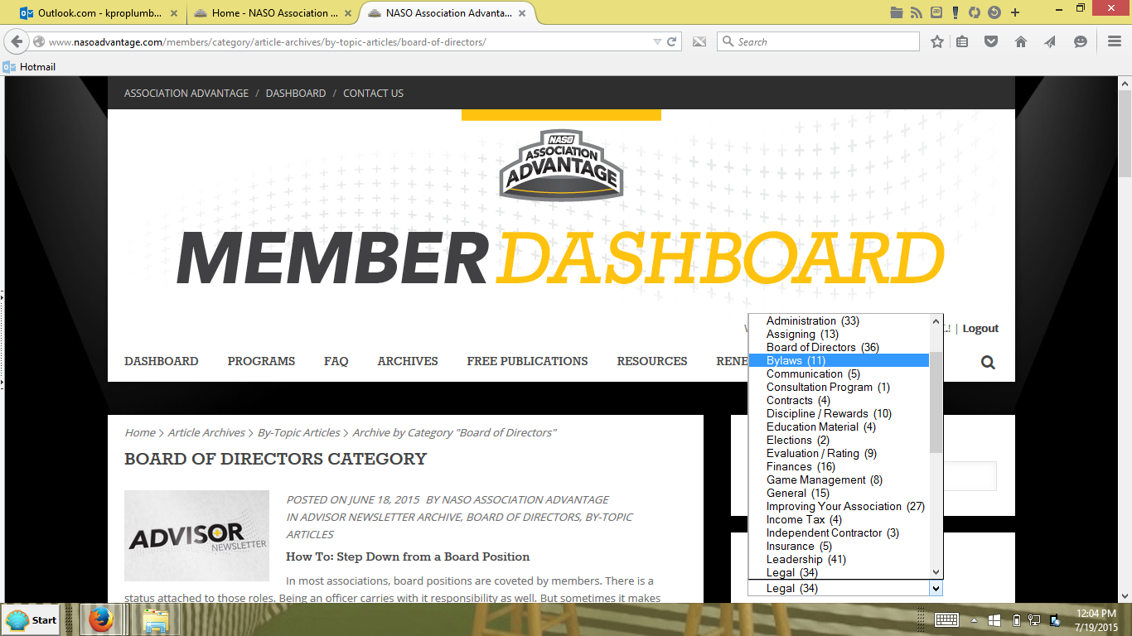
www.nasoadvantage.com
Notes:
The best association resource available to all MHSAA local associations at this time. The MHSAA gives all associations a basic membership to this. Ask your president what login username and password your association has been given and surf your way to the archived resources, some of the hundreds of which are shown on the right side here.

Slide 34
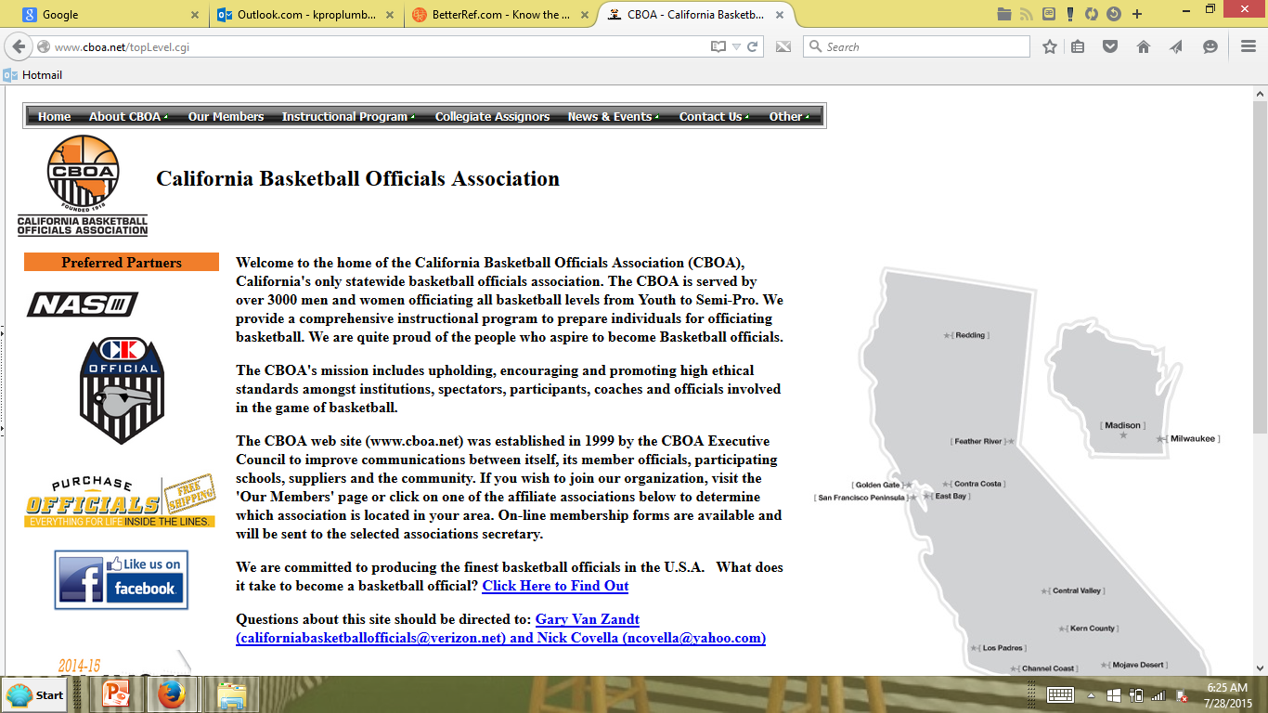
www.cabo.com
Notes:
For some areas of our state without local associations or available trainers, perhaps what the California state association has to offer as far as training for basketball anyway, would be a great alternative for the self-improving basketball official.

Slide 35
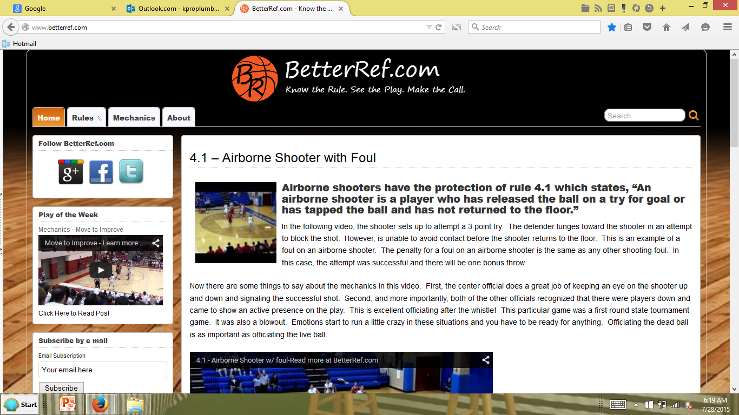
www.betterref.com
Notes:
Another resource for basketball officials who want to study on their own . . .

Slide 36
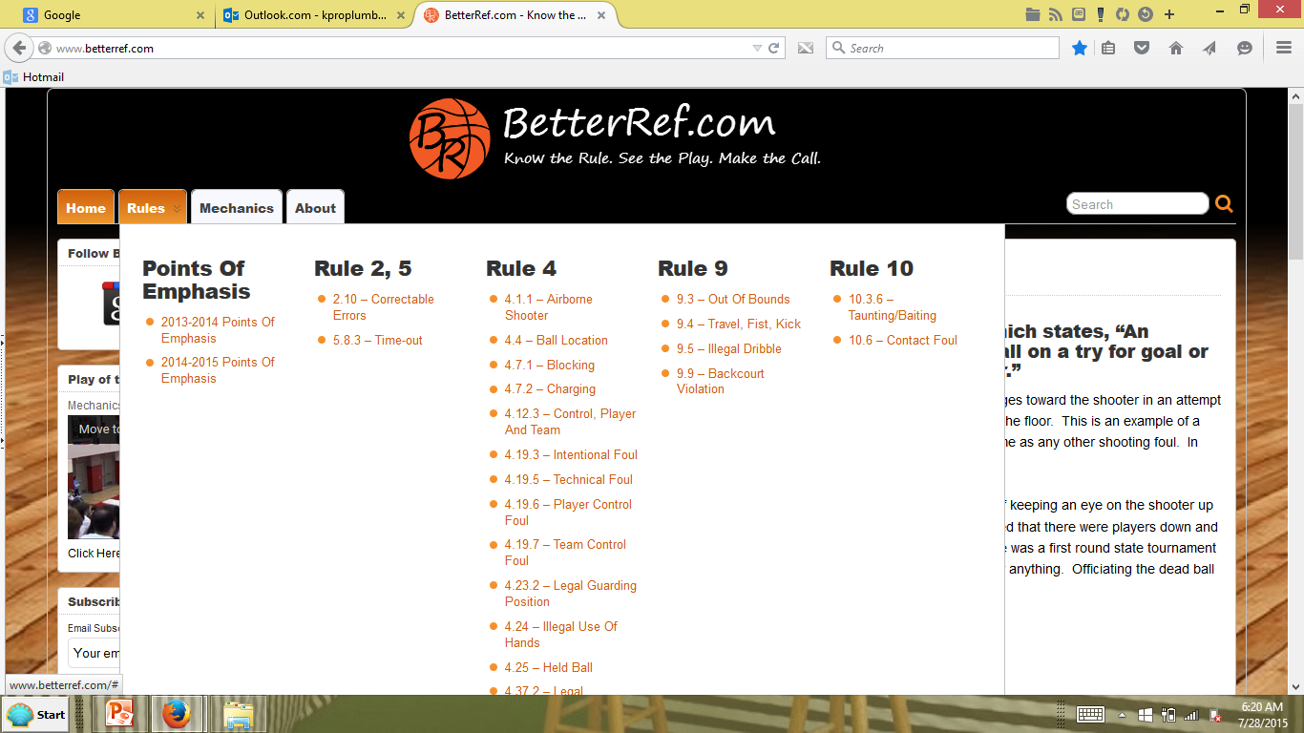
www.betterref.com

Slide 37
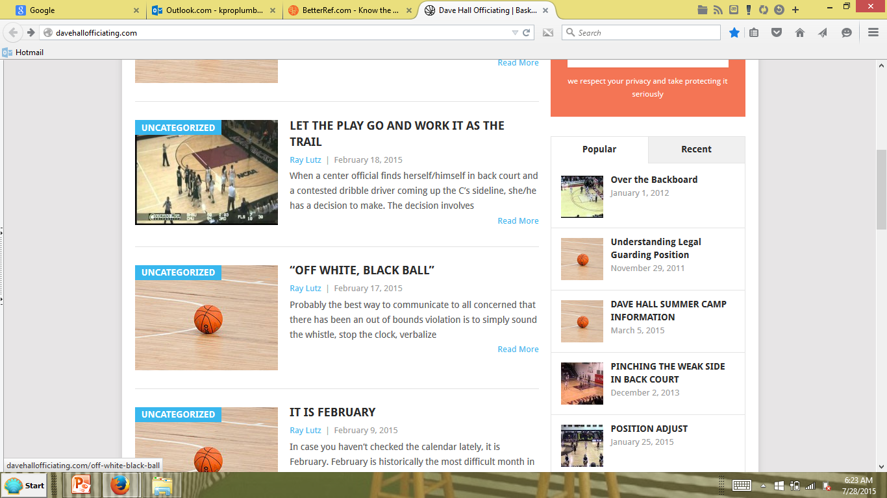
www.davehallofficiating.com
Notes:
Another online resource for basketball officials. There are surely many similar sites for all other sports your association for assisting your trainers with their training curriculum. Online resources may be the only alternative for remote areas of our state where local rules meetings are impossible or impracal.

Slide 38
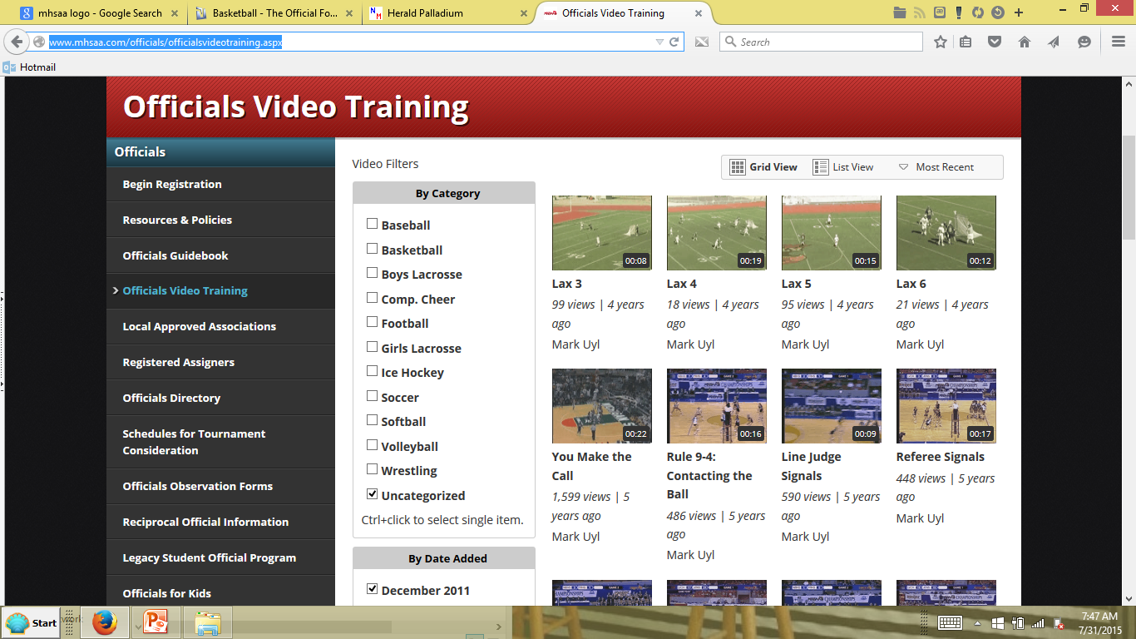
www.mhsaa.com/officials/officialsvideotraining.aspx

Slide 39
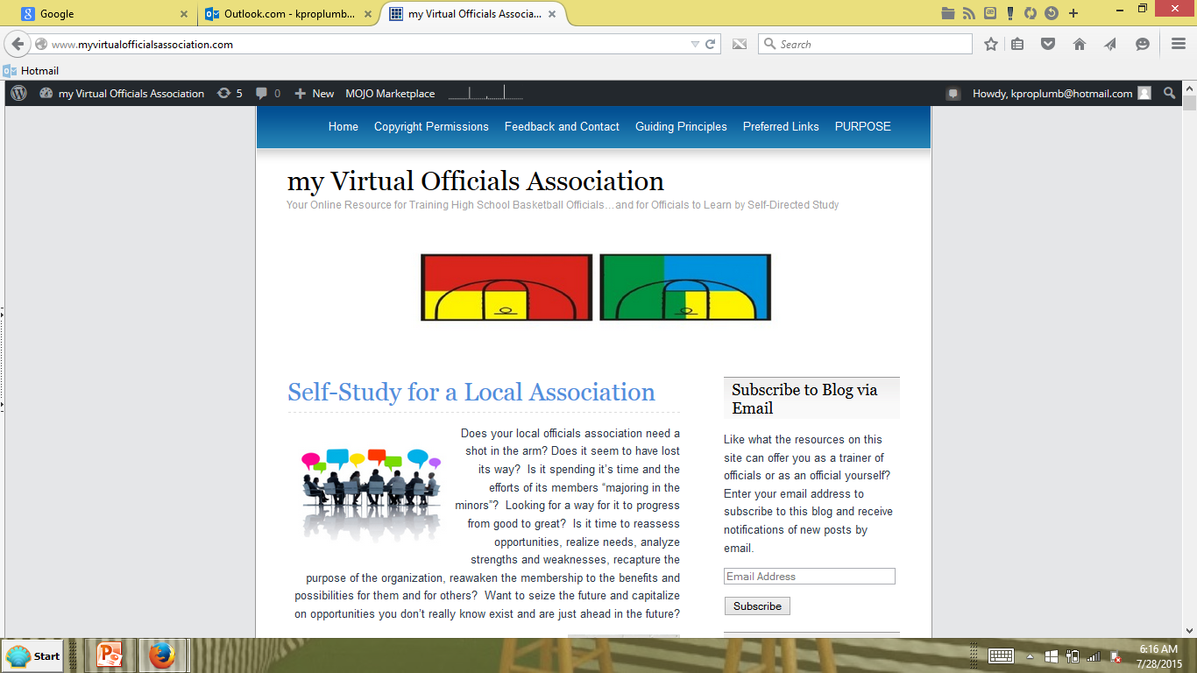
www.myvirtualofficialsassociation.com
Notes:
Here’s an example of one effort by an official here in our state to offer training to those without an association or without a trainer – or for those who just want to get better on their own . . .

Slide 40
NASO – ON articles in Referee magazine
NASO – AA, for which all you have access
www.betterref.com
www.davehallofficiating.com
www.cboa.net
www.myvirtualofficialsassociation.com
MHSAA O.D.O. on the horizon?
RESOURCES

Slide 41
EFFECTIVE AND APPROVED TRAINING –
The Main Thing in Every Association…
Benefiting Every Official…
Available in Person or Online
MY VISION

Slide 42
“Refereeing is not about perfection.
It is about the pursuit of perfection,
and the attainment of excellence
along the way.”
THE MAIN THING
Notes:
Similarly, “leading a local association is not about perfection…” either. But with the resources, encouragement, and methodology presented today, perhaps a pursuit of perfection and attainment of excellence lie ahead for your local association through the enhanced training offered because of your leadership and presence here today!

Slide 43
kproplumb@hotmail.com
Notes:
Email me at any time if you desire any kinds of resources to enhance or implement training as THE MAIN THING in your local association. Freddy Krieger, Fruit Belt Officials Association

